Slide 1
Terraform workspace
ow

Slide 2
Overview
Terraform workspace enables us to manage multiple deployment configuration.`
When we are creating any resource, it is created in default workspace
terraform workspace show
default
Workspaces allow users to manage different sets of infrastructure using the same configuration by isolating state files

Slide 3
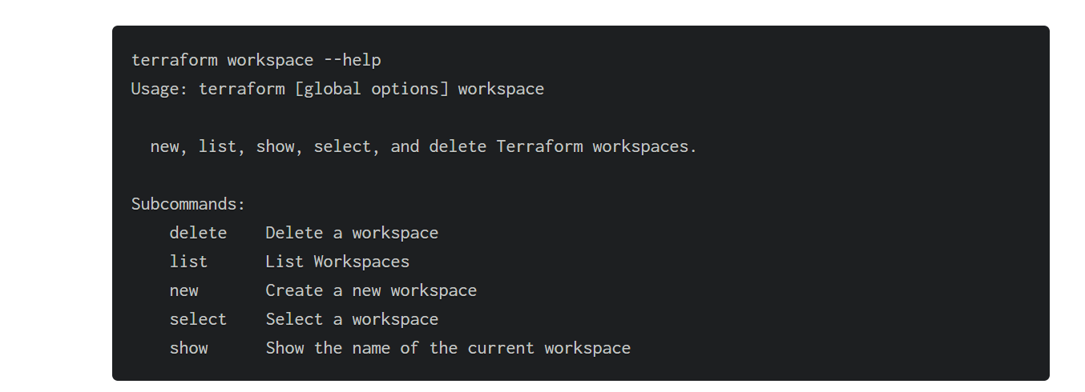
How to use Terraform workspace command

Slide 4
Cmds
terraform workspace show
terraform workspace list
terraform workspace new <workspace name>
terraform workspace select

Slide 5
Terraform workspaces and state file
When we create a new workspace, Terraform creates a corresponding new state file
When we look at the contents of the Terraform state S3 bucket, apart from our default terraform.tfstate file, we can see that a new directory named “env:/” is created, within which another directory with the name of our workspace (test_workspace) is created.

Slide 6
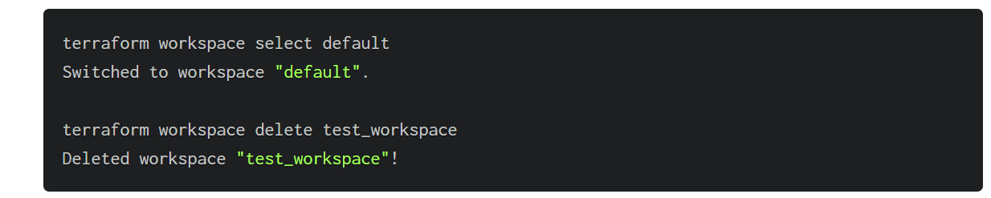
How to delete a Terraform workspace
To delete the workspace, first select a different workspace. In our case, we go back to the default workspace and run the delete command. Terraform does not let us delete the currently selected workspace.

Slide 7
..
Also, if you attempt to delete a workspace where certain resources are being managed by Terraform, it will not let you delete that workspace, suggesting using the -force option instead.
Using the -force option may not be a good idea as we will lose track of all the resources being managed by Terraform.
A better option would be to select that workspace, run the destroy command, and then attempt to delete the workspace again.

Slide 8



